Slide 1
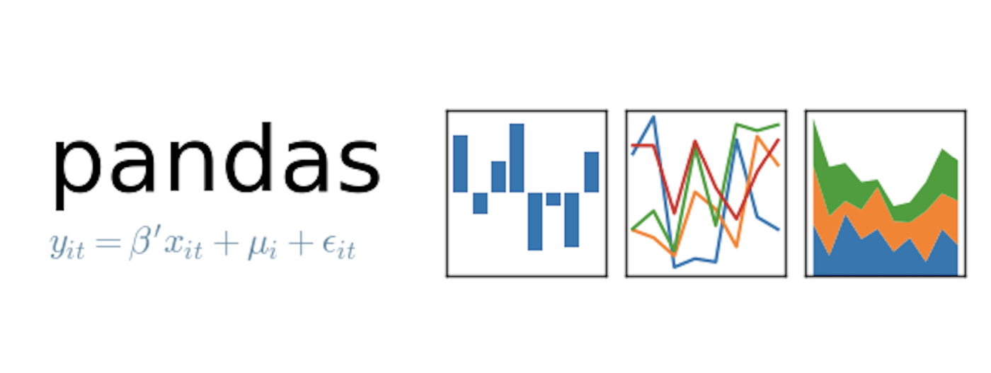
Today’s class
Pandas

Slide 2
Pandas Data Structures: Data Frames, Series, and Indices

Slide 3
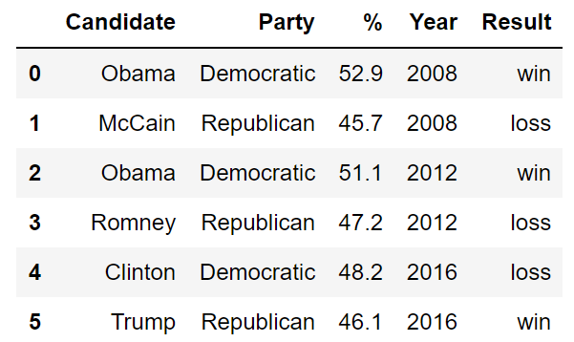
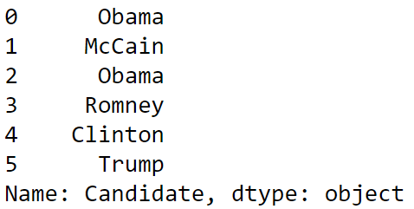
Pandas Data Structures
There are three fundamental data structures in pandas:
Data Frame: 2D data tabular data.
Series: 1D data. I usually think of it as columnar data.
Index: A sequence of row labels.
Series
Data Frame
Index

Slide 4
The Relationship Between Data Frames, Series, and Indices
We can think of a Data Frame as a collection of Series that all share the same Index.
Candidate, Party, %, Year, and Result Series all share an index from 0 to 5.
Candidate Series
Party Series
% Series
Year Series
Result Series

Slide 5
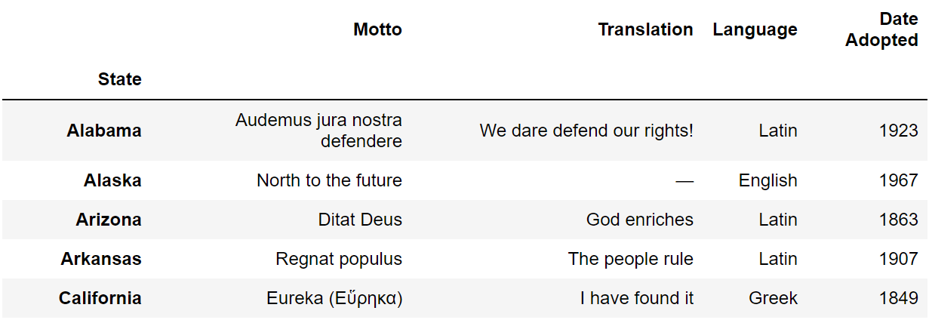
Indices Are Not Necessarily Row Numbers
Indices (a.k.a. row labels) can also:
Be non-numeric.
Have a name, e.g. “State”.

Slide 6
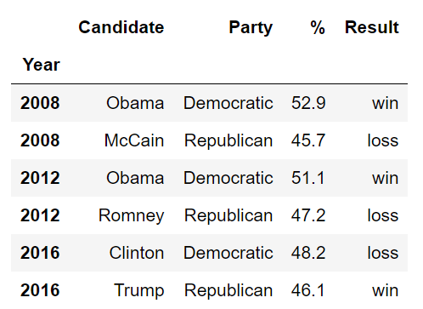
Indices
The row labels that constitute an index do not have to be unique.
Left: The index values are all unique and numeric, acting as a row number.
Right: The index values are named and non-unique.

Slide 7
Column Names Are Usually Unique!
Column names in Pandas are almost always unique!
Example: Really shouldn’t have two columns named “Candidate”.

Slide 8
Indexing with The [] Operator
Notes:
7 minutes

Slide 9
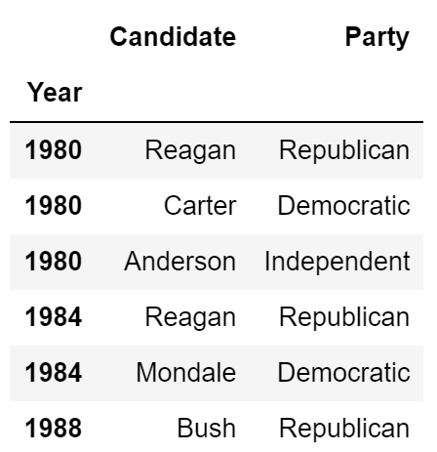
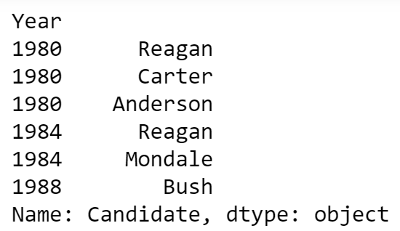
Indexing by Column Names Using [] Operator
Given a dataframe, it is common to extract a Series or a collection of Series. This process is also known as “Column Selection” or sometimes “indexing by column”.
Column name argument to [] yields Series.
List argument to [] yields a Data Frame.

Slide 10

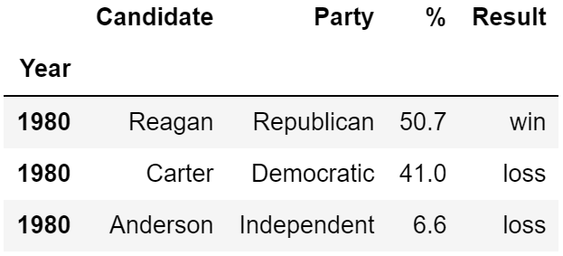
Indexing by Row Slices Using [] Operator
We can also index by row numbers using the [] operator.
Numeric slice argument to [] yields rows.
Example: [0:3] yields rows 0 to 2.

Slide 11
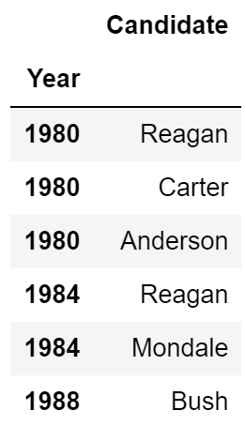
[] Summary
Name
[]
Series
Single Column Selection
List
[]
DataFrame
Multiple Column Selection
Numeric Slice
[]
DataFrame
(Multiple) Row Selection

Slide 12
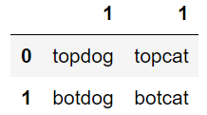
Question
Try to predict the output of the following:
weird[1]
weird[“1”]
weird[1:]
Name
[]
Series
Single Column Selection
List
[]
DataFrame
Multiple Column Selection
Numeric Slice
[]
DataFrame
(Multiple) Row Selection

Slide 13
Boolean Array Selection
and Querying
Notes:
10 min

Slide 14
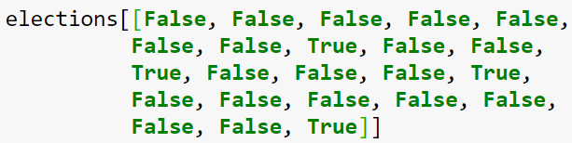

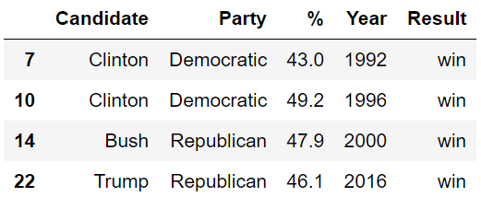
Boolean Array Input
Yet another input type supported by [] is the boolean array.
Entry number 7

Slide 15
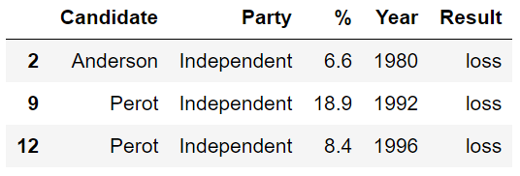
Boolean Array Input
Yet another input type supported by [] is the boolean array. Useful because boolean arrays can be generated by using logical operators on Series.
Length 23 Series where every entry is either “True” or “False”, where “True” occurs for every independent candidate.
Length 23 Series where every entry is “Republican”, “Democrat” or “Independent.”

Slide 16

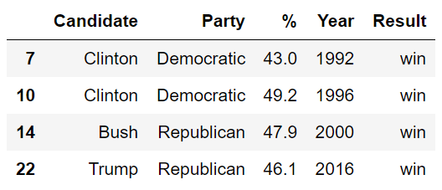
Boolean Array Input
Boolean Series can be combined using the & operator, allowing filtering of results by multiple criteria.

Slide 17
isin
The isin function makes it more convenient to find rows that match one of many possible values.
Example: Suppose we want to find “Republican” or “Democratic” candidates. Could use the | operator (| means or), or we can use isin.
Ugly:
Better:

Slide 18
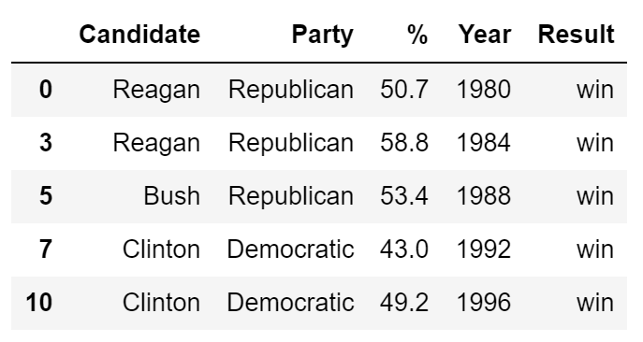
The Query Command
The query command provides an alternate way to combine multiple conditions.

Slide 19
Indexing with .loc and .iloc
Sampling with .sample
Notes:
15 min

Slide 20
Loc and iloc
Loc and iloc are alternate ways to index into a DataFrame.
They take a lot of getting used to! Documentation and ideas behind them are quite complex.
I’ll go over common usages (see docs for weirder ones).
Documentation:
loc: https://pandas.pydata.org/pandas-docs/stable/generated/pandas.DataFrame.loc.html
iloc: https://pandas.pydata.org/pandas-docs/stable/generated/pandas.DataFrame.iloc.html
More general docs on indexing and selecting: Link

Slide 21
Loc
Loc does two things:
Access values by labels.
Access values using a boolean array (a la Boolean Array Selection).

Slide 22
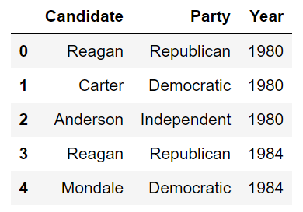
Loc with Lists
The most basic use of loc is to provide a list of row and column labels, which returns a DataFrame.

Slide 23
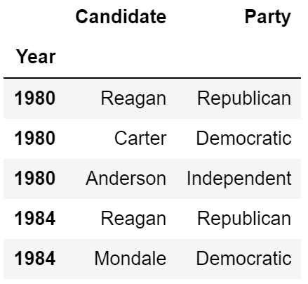
Loc with Lists
The most basic use of loc is to provide a list of row and column labels, which returns a DataFrame.

Slide 24
Loc with Slices
Loc is also commonly used with slices.
Slicing works with all label types, not just numeric labels.
Slices with loc are inclusive, not exclusive.

Slide 25
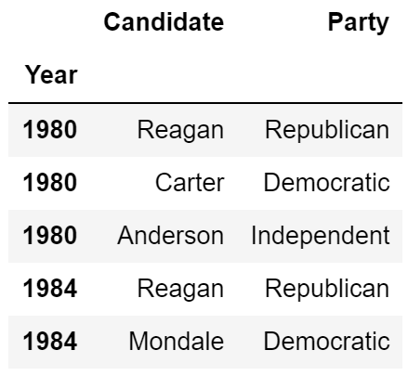
Loc with Slices
Loc is also commonly used with slices.
Slicing works with all label types, not just numeric labels.
Slices with loc are inclusive, not exclusive.

Slide 26
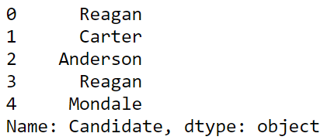
Loc with Single Values for Column Label
If we provide only a single label as column argument, we get a Series.

Slide 27
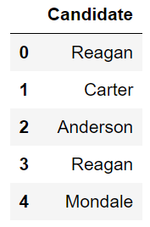
Loc with Single Values for Column Label
As before with the [] operator, if we provide a list of only one label as an argument, we get back a dataframe.

Slide 28
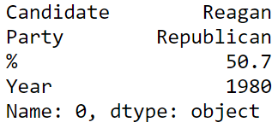

Loc with Single Values for Row Label
If we provide only a single row label, we get a Series.
Such a series represents a ROW not a column!
The index of this Series is the names of the columns from the data frame.
Putting the single row label in a list yields a dataframe version.

Slide 29
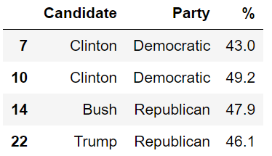
Loc Supports Boolean Arrays
Loc supports Boolean Arrays exactly as you’d expect.

Slide 30


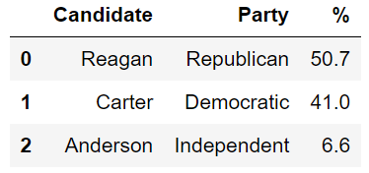
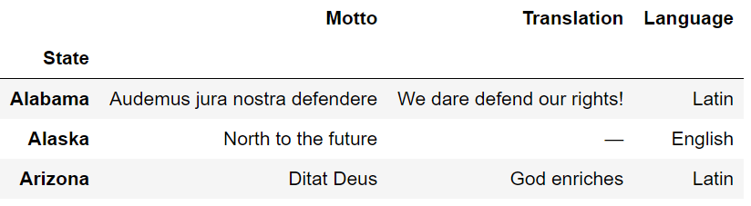
iloc: Integer-Based Indexing for Selection by Position
In contrast to loc, iloc doesn’t think about labels at all. Instead, it returns the items that appear in the numerical positions specified.
Advantages of loc:
Harder to make mistakes.
Easier to read code.
Not vulnerable to changes to the ordering of rows/cols in raw data files.
Nonetheless, iloc can be more convenient. Use iloc judiciously.

Slide 31
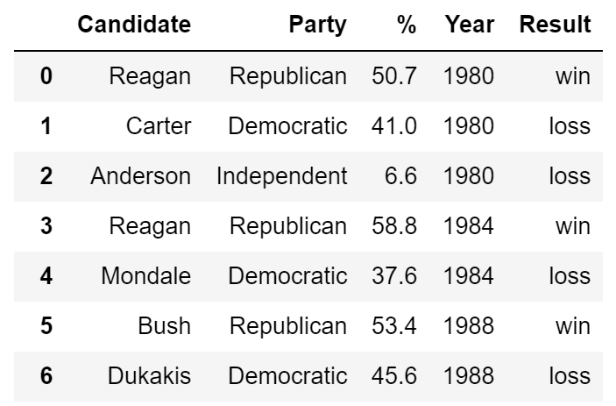
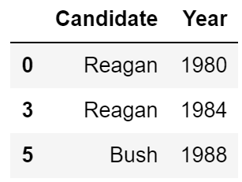
Annoying Question Challenge
Which of the following pandas statements returns a DataFrame of the first 3 Candidate names only for candidates that won with more than 50% of the vote.
elections.iloc[[0, 3, 5], [0, 3]]
elections.loc[[0, 3, 5], ["Candidate":"Year"]
elections.loc[elections["%"] > 50, ["Candidate", "Year"]].head(3)
elections.loc[elections["%"] > 50, ["Candidate", "Year"]].iloc[0:2, :]

Slide 32
Annoying Question Challenge
Which of the following pandas statements returns a DataFrame of the first 3 Candidate names only for candidates that won with more than 50% of the vote.
elections.iloc[[0, 3, 5], [0, 3]]
elections.loc[[0, 3, 5], ["Candidate":"Year"]
elections.loc[elections["%"] > 50, ["Candidate", "Year"]].head(3)
elections.loc[elections["%"] > 50, ["Candidate", "Year"]].iloc[0:2, :]
See notebook for why!

Slide 33

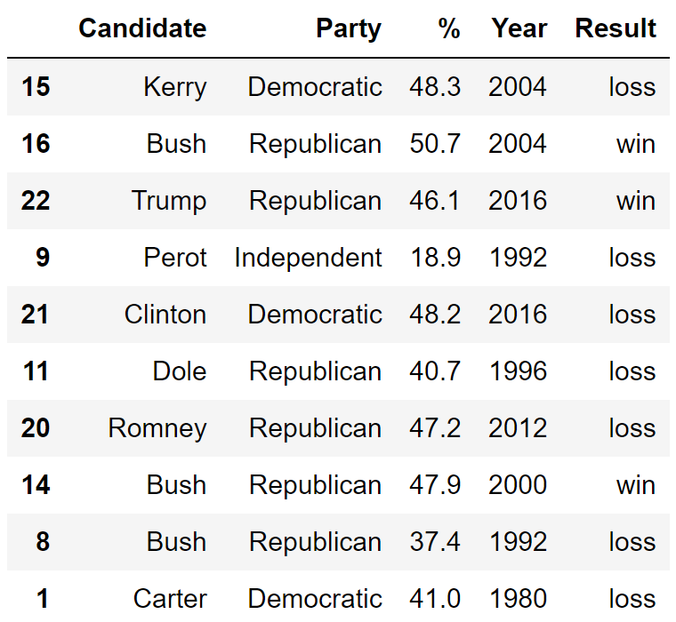
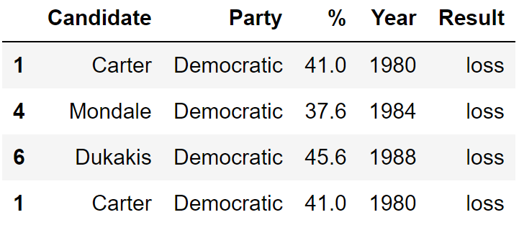
Sample
If you want a DataFrame consisting of a random selection of rows, you can use the sample method.
By default, it is without replacement. Use replace=true for replacement.
Naturally, can be chained with our selection operators [], loc, iloc.

Slide 34
Handy Properties and Utility Functions for Series and DataFrames

Slide 35
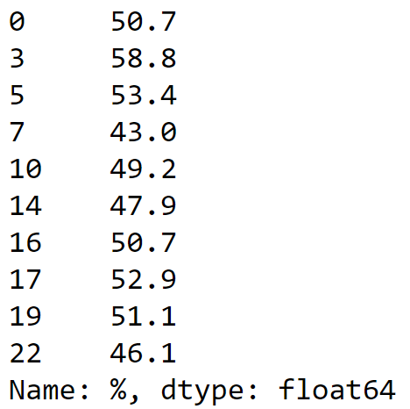




Numpy Operations
Pandas Series and DataFrames support a large number of operations, including mathematical operations so long as the data is numerical.

Slide 36
head, size, shape, and describe
head: Displays only the top few rows.
size: Gives the total number of data points.
shape: Gives the size of the data in rows and columns.
describe: Provides a summary of the data.

Slide 37
index and columns
index: Returns the index (a.k.a. row labels).
columns: Returns the labels for the columns.

Slide 38
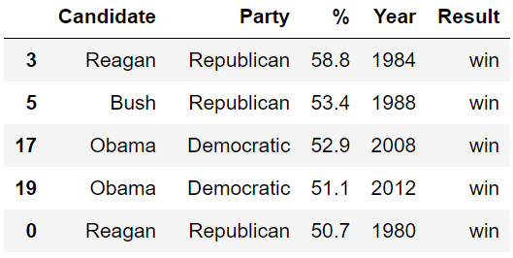
The sort_values Method
One incredibly useful method for DataFrames is sort_values, which creates a copy of a DataFrame sorted by a specific column.

Slide 39
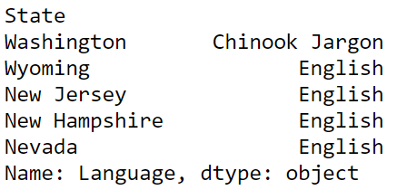
The sort_values Method
We can also use sort_values on a Series, which returns a copy with with the values in order.

Slide 40
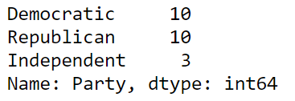
The value_counts Method
Series also has the function value_counts, which creates a new Series showing the counts of every value.

Slide 41

The unique Method
Another handy method for Series is unique, which returns all unique values as an array.

Slide 42
The Things We Just Saw
sort_values
value_counts
unique

Slide 43
Summary
Operations on String series, e.g. babynames[“Name”].str.startswith()
Creating and dropping columns.
Creating temporary columns is often convenient for sorting.
Passing an index as an argument to loc.
Useful as an alternate way to sort a dataframe.

